Slide 1
account management 101

Slide 2
what we will cover:
Account management roles
Tips
Relationships with clients
How to Have Successful Meetings
Resources

Slide 3
account manager duties
Liaison between your team and the agency partner
Managing, reviewing progress, and helping deliver projects
Conducting meetings with the clients as well as informing them about the current work status of their projects
Creates Slide Decks with their Account Executive and agendas for each meeting
Leading project team meetings and monitoring performance

Slide 4
account manager duties
Training new Account Executives
Sending weekly updates to adworks President, VP, and Creative Director
Creates a timeline for the agency in the beginning of the semester and takes the lead on direction

Slide 5
about account executive
The Account Executive is the right-hand man for the Account Manager. Account Executives assist with the project team's internal communications, such as brainstorming sessions. It's also expected that the Account Executive contributes in other areas of the project and checks in on each project member for assistance.

Slide 6
account executive duties
“Right hand man” to the Account Manager
Assisting accounts with team meetings and work progress
Helping create internal creative briefs for art direction
Coordinating with team to present findings and creative work to the agency partner
Organizing and leading focus groups and brainstorming sessions

Slide 7
account executive duties
Create a timeline for the semester with the Account Manager
Ensuring the strategy and key insight is seen through in the campaign/creative work

Slide 8
accounts tips

Slide 9
respond in a timely manner
DO NOT wait until you have all the answers to answer an email
Have you ever sent an email and heard back a week later? Kind of irritating, right? Why would we do this to clients then?
Figure out what things are pressing and what are not
Guess what, you can ask your client these things!
It’s okay to respond with - on it! Will get back to you by tomorrow EOD (unless it’s urgent)

Slide 10
what is timely?
Answers to emails? - 24 hours (MAX)
Returning phone calls? - 1-2 hours
Returning text messages? - (if this is a thing) ASAP

Slide 11
how to communicate with partners
Agency life is HECTIC
Do not be afraid to follow up with your point of contact if they did not get back to you when promised
  And be prepared to send another one after that...and that.

Slide 12
how to communicate with partners
CC Jordan and Michael on ALL agency communication! (plz and thanks.)
Jordan: [email removed] Michael: [email removed]
All deliverables being presented to the partner (decks + creative) must be sent 48 hours prior to your meeting.
Zach must see all creative assets before going to the partners!

Slide 13
example of how to phrase follow-up
Hi David and Shelby,
I wanted to ensure that you received my below email, as I received a proposal for a meeting time tomorrow from Shelby earlier today! As I specified in my previous email, Tuesdays and Thursdays are generally difficult days to get our team together due to school obligations. Please let me know if there is a good time for me to call either of you and sort out our schedules, or if the times I suggested in my last email may work better!
Best,
Kaylie

Slide 14
successful meetings

Slide 15
the six steps
What are we trying to achieve?
What does success look like?
Produce results (AKA Put in werk) accounts must delegate and contribute -- especially with strategy work
Consistent communication: with agency and team
Meet as a project team: find a consistent weekday if possible
Final Pitch: rehearse, rehearse, rehearse

Slide 16
let’s schedule a meeting
Typically, each project team will meet with the agency partner ~4 separate times
  Kickoff Meeting, Strategy Presentation, Present Ideas off Insights, Final Pitch
Number of meetings can vary due to the type of project, the agency, and the wants/needs of the project team
When coordinating a time/date to meet with the agency partner, there MUST be at least 1 E-board executive present!
  Always helps to have a familiar face cheering you on and can help answer and ask any questions during the meeting
Google Calendar Invite is a must

Slide 17
early is on time, on time is late...
For reals… Even one minute late is showing disrespect for their time
If you are late… CALL IT OUT
A genuine apology let’s the client know you recognize their time and it’s valuable
Alert the second you know you will be late
Preparation is key… Find ways to move quickly from one meeting to the next
Download conference software to your device(s)
Meetings will be in person or virtual, regardless, be on time and be flexible if the agency wants to meet in person or virtual

Slide 18
always have an agenda
Send it the day before the meeting (or at minimum 2 hours prior to meeting)
Keep it brief
An agenda for your team meetings AND agency meetings
What is BRIEF??

Slide 19
agenda examples
THIS IS A GOOD AGENDA
THIS IS A BAD AGENDA
Introductions
Housekeeping items
Performance review
Recap of action items
Next steps and owners
Start with introductions
  First I will introduce myself how long I’ve been here, then the director, the analyst, reporting manager, and my dog.
We will tackle housekeeping items
  We will discuss how often we will have meetings, preference in communication, your favorite food and how great the Kansas Jayhawks are.
Reviewing performance of all paid media campaigns and metrics.
  We will review each region in depth looking at impressions, clicks, CTR, spend, Conv. Rate, CPA and how awesome I am at optimizing your campaigns.
Discuss action items as well as timelines.
  We will discuss all the action items we had from the beginning of the call and then figure out when we will get everything done.
Discuss next steps and assign owners, deadlines and everything in between.
  Seriously this is the longest agenda ever but I shit you not I see these things on a weekly basis.
    Don’t do it.

Slide 20
ask questions
If something doesn’t make sense
GET CLARITY
Chances are that you’ll get the project wrong if you don’t clearly understand the objective

Slide 21
good questions to ask
How can we measure success?
Is there anyone else involved in this purchasing decision?
Can you tell me more about that?
Can you give me an example of [x]?
What do you think about this so far? Do you have any feedback on _?
Do you have any concerns or issues so far?
What other areas would you like to discuss moving forward?
What are you doing this weekend? (be personable and get to know the team)

Slide 22
document, document, document
Do your team a solid and ADD what you’ve learned
Example - if you have a point of contact that can’t stand grammar mistakes, put this in your internal playbook!
GOOGLE CALENDAR INVITES:
Send Google Calendar invites for all internal meetings and agency meetings -- loop in Michael and Jordan as well
Agencies appreciate having the link and scheduled event on their calendar
It’s the little things

Slide 23
always send a recap.
And send it timely...
Always take notes
  “Notes” does NOT mean a transcription of the entire conversation… Ain’t nobody got time for that!
  Notes are the big callouts or action items to reference later
Again, brevity is key!
It’s easy to send something lengthy without summarizing
It’s HARD to condense… Go the hard route with this one
Be timely: You should send the day of… If it’s at the end of the day, first thing the next morning

Slide 24
document, document, document
Do your team a solid and ADD what you’ve learned
Example - if you have a point of contact that can’t stand grammar mistakes, put this in your internal playbook!
GOOGLE CALENDAR INVITES:
Send Google Calendar invites for all internal meetings and agency meetings -- loop in Michael and Jordan as well
Agencies appreciate having the link and scheduled event on their calendar
It’s the little things

Slide 25
client relationships

Slide 26
consistent communication
Create a communication plan that is consistent
Status call frequency
Reporting reviews
Strategic sessions
Establish main points of contact
Know your main point of contact
  Or their back up
Be clear in communicating our main point of contact as well as key players

Slide 27
listen
There is nothing more basic than listening, yet most people don’t actually listen!
If you listen well, you won’t miss out on key insights
You are NOT listening to respond
You need to show up to each meeting without barriers

Slide 28
confidence
When you lack confidence in what you are talking about, clients are more likely to question your guidance
Know your crutch words
If you don’t… Ask a friend! Record yourself!
What are some common crutch words?
STOP using “I think”, “I believe”, “kind of”, “maybe” and “could/should” right?

Slide 29
organization
Make a shared Google Drive (share with EVERY member on project team and EVERY member of e-board)
Keep e-board in the loop with agency meetings (want to have 1 member of e-board at every agency meeting)
Let us know if you have any issues with team members or communication
Delegate and make sure everyone has clear expectations
Utilize a timeline (in member resources folder) and share it with the agency for a rough timeline

Slide 30
organization
Tell your group that it’s OKAY to ask questions (whether it be about their role or their approach)
Rehearse as a team for presentations
Use when2meet if you’re having trouble finding a time to meet
Send all creative assets to Zach in advance
Send all deliverables and presentation assets to Michael and Jordan
Take initiative in meetings with the agency, you’re the leader and running the show

Slide 31
take the bullet
Apologize for mistakes!
  In many situations, clients just want you to admit when something was wrong and they can move on
YOU are the face
  If we (your team) screw up, you are the one that falls on the sword
Take the lead on all meetings, you run the show, but include everyone in the conversation

Slide 32
take the bullet
Apologize for mistakes!
  In many situations, clients just want you to admit when something was wrong and they can move on
YOU are the face
  If we (your team) screw up, you are the one that falls on the sword
Take the lead on all meetings, you run the show, but include everyone in the conversation

Slide 33
project tips
Make sure slide decks are cohesive, tell a story - STRATEGY IS ALWAYS ALIGNED
Ensure both team members are collaborating for each role (ex: art directors work together not separately)
Encourage the team to really think outside of the box for creative ideas -- our partners are looking for unique ideas for the future of advertising. To get inspiration look at the https://clios.com/awards and www.adsoftheworld.com/
Make sure all assets look they are from the same campaign

Slide 34
resources

Slide 35
resources

Slide 36
resources about accounts
Memos for Account Management: The following memos were created by Bruce Kelley, Vice Chairman, The Martin Agency to provide tips and recommendations for agency staff, primarily Account Management, to help deal with the myriad issues faced on the job.
What do Account Directors and Account Managers do in advertising?

Slide 37
get to know your team
Be a mentor
Personality quizzes
Go get lunch or walk to meetings together, etc.

Slide 38
recommended tools
Groupme or all project communication, text message for reminding about meetings or quick questions (e-board included on both)
Miro: great collaboration tool, have a few free boards Jamboard: another great collaboration tool
Google Drive
Excel sheet mapping out dates
When2Meet to find times with team

Slide 39
ae’s vs am’s in the real world
AE: Their primary responsibility is to build relationships with new clients while helping to cultivate relationships with existing ones. They are the primary point of contact for prospective clients, offering them guidance while simultaneously assessing their needs and making sure they can be met. Account executives aim to make connections with new clients through networking events, research, sales calls and visits, and other promotional tactics. A primary responsibility is to employ sales principles to forge relationships with new clients and earn their business. For this reason, their daily tasks often involve networking and promotion. They might also create media pitches, reach out to social media influencers, provide product samples for editorial promos, organize promotional events, and more. It’s vital that account executives be able to communicate effectively, both verbally and in writing.
AM: Account managers are the liaison between a business and its existing clients. They may monitor budgets, explain cost factors to clients, and negotiate new terms as necessary. Since account managers often juggle many clients, they must be detail-oriented and able to multitask and manage priorities according to company and client needs. They also must have good communication skills to delegate tasks as necessary. Account managers handle clients who are already signed on to work with the company, ensuring the relationship remains beneficial for both parties. This may involve renegotiating contracts, communicating with other departments to ensure deliverables are high-quality and on schedule, and confirming that both the business and the client are able to meet the terms of their agreement. As such, they spend most of their time in the “office” connecting with clients through email and by phone although they do make client visits.

Slide 40
ae’s vs am’s in the real world
While both must have good interpersonal skills, the role of account executive requires extensive knowledge of sales tactics and the psychology of sales. They use these skills, coupled with interpersonal communication, to land new clients.
Account managers don’t develop new accounts but rather maintain and nurture existing ones. While they need interpersonal skills, too, it’s just as important that they be able to manage their time to serve their clients well.

Slide 41
getting to
your big idea

Slide 42
big idea
Based on the strategy, work with your team to develop a north star or your BIG IDEA
  Ex: For Tinder, we found teens want more meaningful connections beyond the phone screen. Our big idea was to create digitally disruptive experiences -- encourage teens to meet beyond the phone screen
Based on this big idea, make sure the creative ideas revolve around this strategy
You can also present multiple big ideas if you are having trouble narrowing down to one
Think outside of the box, write everything down that comes to mind when doing brainstorming sessions with the entire team

Slide 43
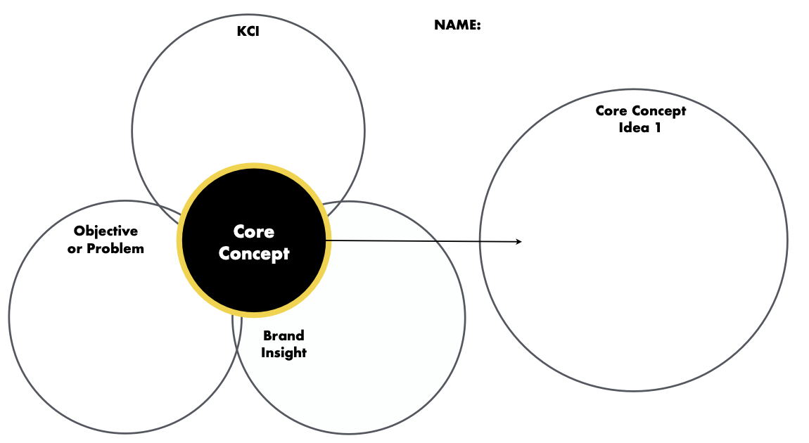
core concept frameworks
Using this framework can help you get to your big idea

Slide 44
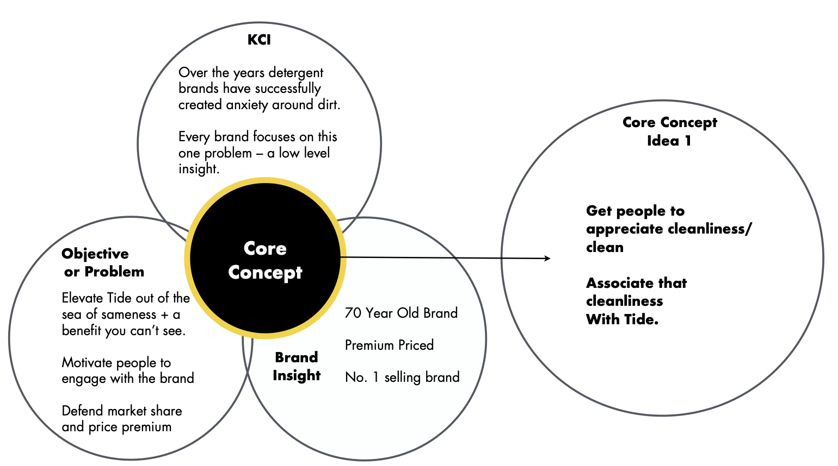
core concept frameworks
Using this framework can help you get to your big idea

Slide 45
now go KICK SOME ASS!

